Slide 1
What is SQOOP in Hadoop?
Apache Sqoop (SQL-to-Hadoop) is designed to support bulk import of data into HDFS from structured data stores such as relational databases, enterprise data warehouses, and NoSQL systems. Sqoop is based upon a connector architecture which supports plugins to provide connectivity to new external systems.

Slide 2
An example use case of Sqoop
is an enterprise that runs a nightly Sqoop import to load the day's data from a production transactional RDBMS into a Hive data warehouse for further analysis.

Slide 3
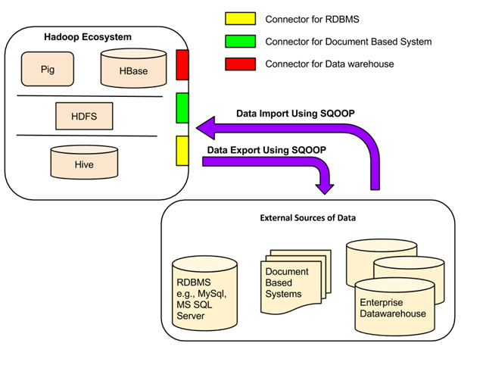
Sqoop Architecture

Slide 4
All the existing Database Management Systems are designed with SQL standard in mind. However, each DBMS differs with respect to dialect to some extent. So, this difference poses challenges when it comes to data transfers across the systems. Sqoop Connectors are components which help overcome these challenges.

Slide 5
Data transfer between Sqoop and external storage system is made possible with the help of Sqoop's connectors.
Sqoop has connectors for working with a range of popular relational databases, including MySQL, PostgreSQL, Oracle, SQL Server, and DB2. Each of these connectors knows how to interact with its associated DBMS. There is also a generic JDBC connector for connecting to any database that supports Java's JDBC protocol. In addition, Sqoop provides optimized MySQL and PostgreSQL connectors that use database-specific APIs to perform bulk transfers efficiently.

Slide 6
In addition to this, Sqoop has various third-party connectors for data stores,
ranging from enterprise data warehouses (including Netezza, Teradata, and Oracle) to NoSQL stores (such as Couchbase). However, these connectors do not come with Sqoop bundle; those need to be downloaded separately and can be added easily to an existing Sqoop installation.

Slide 7
Why do we need Sqoop?
Analytical processing using Hadoop requires loading of huge amounts of data from diverse sources into Hadoop clusters. This process of bulk data load into Hadoop, from heterogeneous sources and then processing it, comes with a certain set of challenges. Maintaining and ensuring data consistency and ensuring efficient utilization of resources, are some factors to consider before selecting the right approach for data load.

Slide 8
Major Issues
1. Data load using Scripts
The traditional approach of using scripts to load data is not suitable for bulk data load into Hadoop; this approach is inefficient and very time-consuming.
2. Direct access to external data via Map-Reduce application
Providing direct access to the data residing at external systems(without loading into Hadoop) for map-reduce applications complicates these applications. So, this approach is not feasible.

Slide 9
Basic Commands and Syntax for Sqoop
Sqoop – IMPORT Command
sqoop import --connect jdbc:mysql://localhost/employees --username nielit --table employees
After the code is executed, you can check the Web UI of HDFS i.e. localhost:50070 or 9870 where the data is imported.

Slide 10
Sqoop – IMPORT Command with target directory
sqoop import --connect jdbc:mysql://localhost/employees --username nielit --table employees --m 1 --target-dir /employees
Sqoop imports data in parallel from most database sources. You can specify the number of map tasks (parallel processes) to use to perform the import by using the -m or –num-mappersargument. Each of these arguments takes an integer value which corresponds to the degree of parallelism to employ.

Slide 11
Sqoop – Incremental Import
Sqoop provides an incremental import mode which can be used to retrieve only rows newer than some previously-imported set of rows. Sqoop supports two types of incremental imports:append and lastmodified. You can use the –incremental argument to specify the type of incremental import to perform.

Slide 12
sqoop import --connect jdbc:mysql://localhost/employees --username nielit --table employees --target-dir /Latest_Employees --incremental append --check-column emp_no --last-value 499999

Slide 13
Sqoop – Import All Tables
sqoop import-all-tables --connect jdbc:mysql://localhost/employees -–username nielit
Sqoop – List Databases
sqoop list-databases --connect jdbc:mysql://localhost/ --username nielit
Sqoop – Export
sqoop export --connect jdbc:mysql://localhost/employees --username nielit --table emp --export-dir /user/nielit/employees

Slide 14
Sqoop – Codegen
In object-oriented application, every database table has one Data Access Object class that contains ‘getter’ and ‘setter’ methods to initialize objects. Codegen generates the DAO class automatically. It generates DAO class in Java, based on the Table Schema structure.
The command for generating java code is: sqoop codegen --connect jdbc:mysql://localhost/employees --username nielit --table employees

